Slide 1
STAC WARS | PS 4| MINING THE ASTROIDS
AKS-3 Presents
Mining the Asteroids with no propellant needed
This is where the fun begins…
Governments of the world have come together to create a massive deep space habitat and industrial complex at Earth-Sun L4 as a stepping stone to making humanity truly space faring and are looking for partners and suppliers for the same….
Team: AKS-3 (Hello there!)

Slide 2
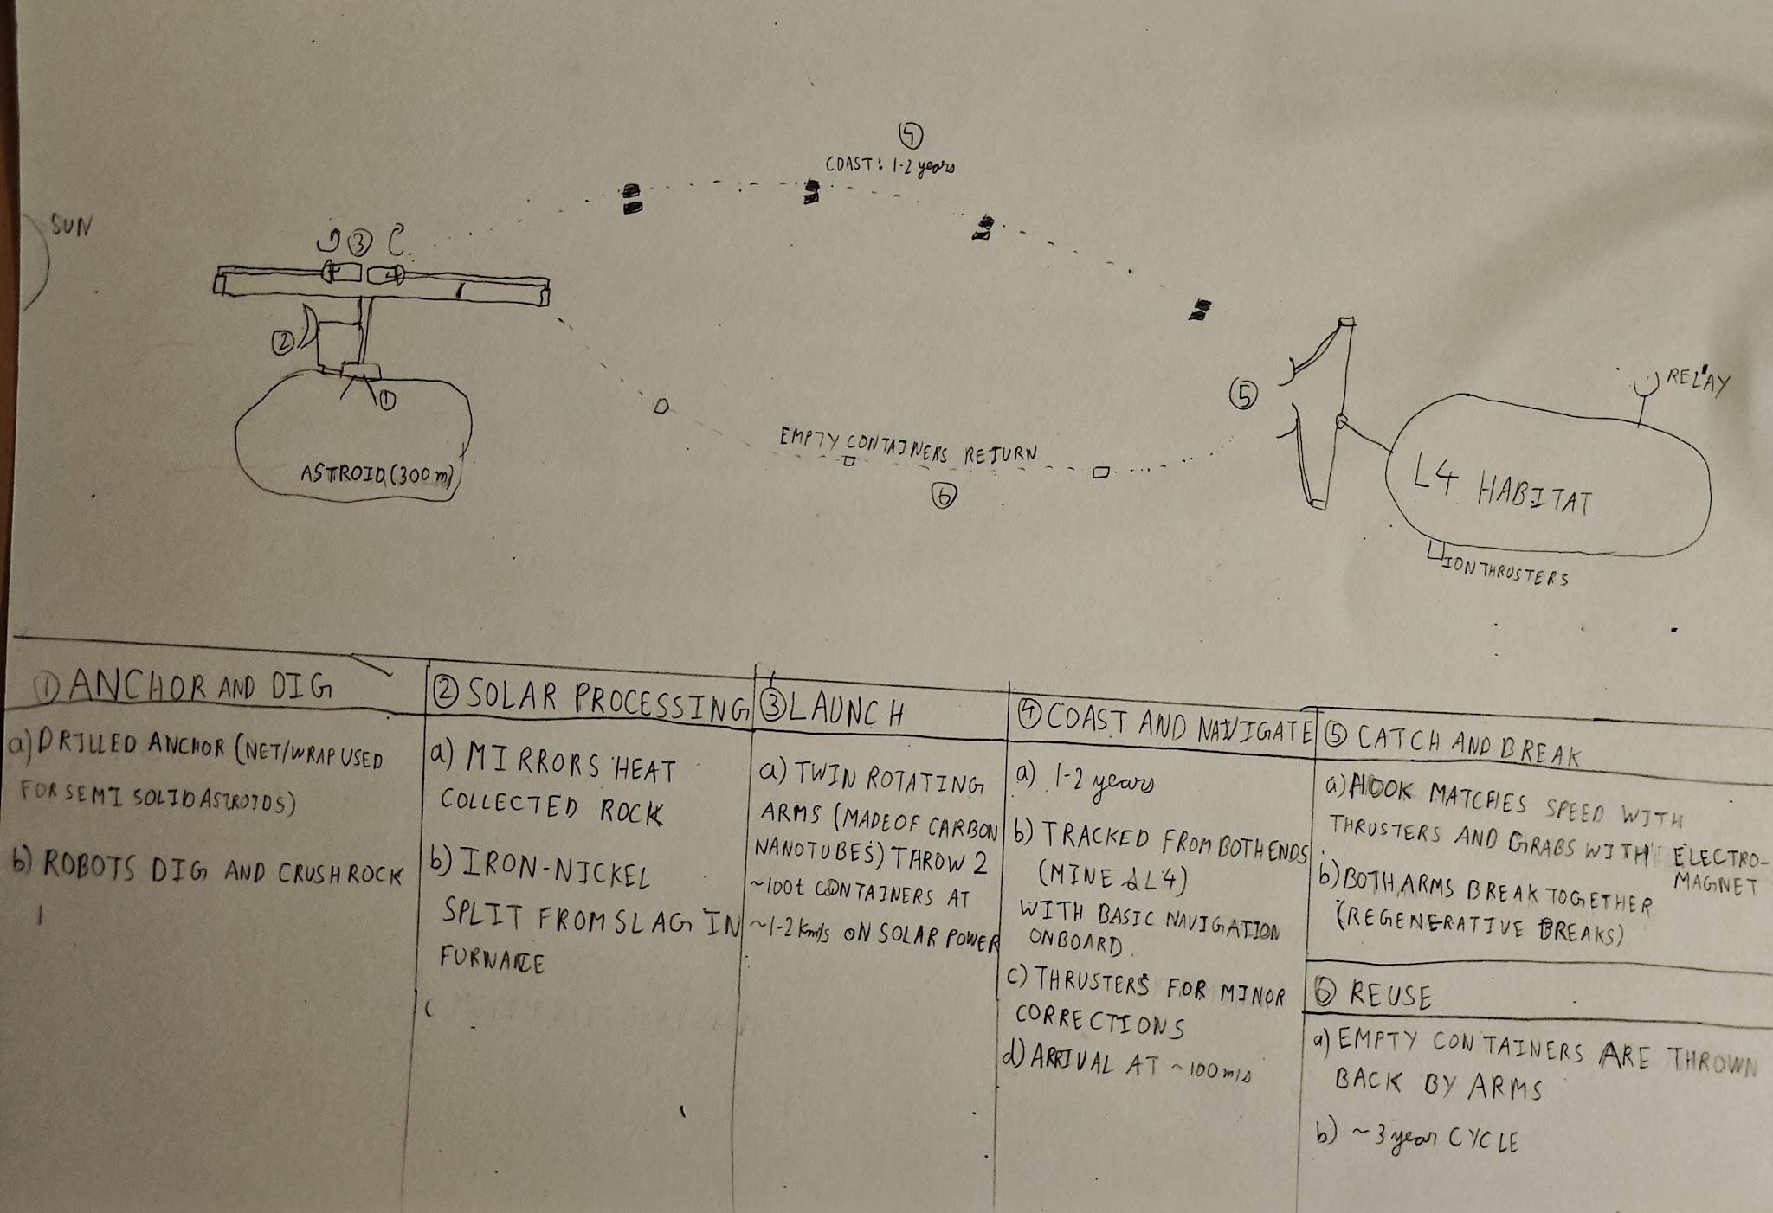

Slide 3
AKS-3 | STAC WARS • PS 4 | 03
How it operates
1. Scout and anchor
navigation and communication
Survey the target near earth asteroid; approach at walking pace. Drill into solid rock or use a net/mesh for rubble piles.
containers only has basic star navigation along with transponder and communication devices.
containers have small thrusters for maneuvering and are solar powered. autonomous control available to control thrusters, can also be remote controlled
Navigation is mostly handled from both L4 and asteroid mine acting as relay stations.
2. Mining and refining
robotic arms dig up rock and crush it. solar powered furnace separates metal from slag
Repair and maintenance
on site robots and spare parts available for repairs.
sensors installed to detect any damage or malfunction
minimum complexity refining and no contact motors for minimum wear and tear
3. launch and catch
the solar powered arms throw containers containing metal and slag towards the destination where robotic arms catch it using electromagnets after they are moving at little relative velocity
bonus: materials existing in 2026 can be used to make the launcher for near earth asteroids’s but to ensure that the system can be scaled up to be used in astroid belt, we are proposing a technological breakthrough: carbon fibre nano tubes to maximum strength at the high velocities required at the hook
3

Slide 4
AKS-3 | STAC WARS • PS 4 | 04
Three major cost drivers
1. Hardware from Earth
2. Moving the cargo
3. Downtime and repair
Problem: launching every replacement part is expensive.
Proposed fix: make frames and wear parts from asteroid iron.
Assumption: on-site iron processing works.
Problem: tugs need engines and propellant to move each load.
Proposed fix: solar tether launch plus light reusable containers.
Assumption: shell mass is ~2% of payload.
Problem: help is far away and repairs can take a long time.
Proposed fix: modular parts, parallel units and repair robots.
Assumption: robots can replace parts autonomously.
Model baseline: 100,000 t/year; 15-year expected life; container fleet estimated at ~90% of transport cost
4

Slide 5
AKS-3 | STAC WARS • PS 4 | 05
Comparison with other approaches
“Never tell me the odds” -Han solo
Dimension
Tug-based mining
Full Astroid Relocation
AKS-3 concept
Cargo movement
Tug carries each load with its own engines
Complete asteroid moved
Solar tether and reusable containers
Propellant
Chemical ~40% of cargo; electric ~5% at 1.5 km/s
alot of propellant required
~0.3% for station-keeping (assumed)
Throughput
Batches per trip
the entire asteroid
Target: 100,000 t/year
Weak point
Fleet cost rises with volume
a lot of fuel wasted in transporting; high risk near the habitat
Tether is unproven; container mass matters
our concept is clearly superior to chemical propulsion and easily beats electric propulsion at higher volumes
5

Slide 6
AKS-3 | STAC WARS • PS 4 | 06
Part C: Business model
The business case depends on a reliable customer at L4.
What we sell
Who buys it?
How funding works
• Rubble for shielding
• Iron-nickel for hulls
• Water and volatiles. water as possible propellant feedstock as a later addition
• Platinum-group metals as a byproduct
Anchor customer: L4 project organising committee.
Possible second buyer: a shipyard building deep-space craft at L4.
Assumption: customers value in-space supply because it avoids launching from Earth.
1. Han funds a technical demo.
2. Demo milestones unlock a capex advance from the L4 organising committee
3. Deliveries repay the advance through rebates.
4. Expand to the asteroid belt if near-Earth targets deplete.
Revenue: per-tonne supply contract. Pricing below Earth-launch cost is an assumption, not a confirmed market price.
6

Slide 7
AKS-3 | STAC WARS • PS 4 | 07
Risks and roadmap
Test the difficult parts early before committing to the full system.
Single customer
PROPOSED ROADMAP
Minimum-purchase clause, termination payment for unrecovered capex, and a second buyer.
1. Demo
Scout, anchor, small launch and catch in order to seqire funding
Tether strength
2.rubble and
metal
Deliver shielding mass to L4; provide hull building material
carbon nanotubes for maximum strength and spare tether on site in case of breakage.
3. volatiles and
propellant
start selling water as propellant; provide habitat with volatiles like carbon, hydrogen, oxygen, nitrogen from c-type asteroids
Anchoring failure
Survey each target and choose drilled anchors, netting or wrapping as appropriate.
4.expand the operations
start mining in asteroid belt as the demand increases, start supplying to the ship building and other industries at L4 and beyond
note: Han's equity in the company and other terms still to be agreed.
7

Slide 8
AKS-3 | STAC WARS • PS 4
Thank you
May the code be with you…
no propellant launch| long-term demand

